Slide 1




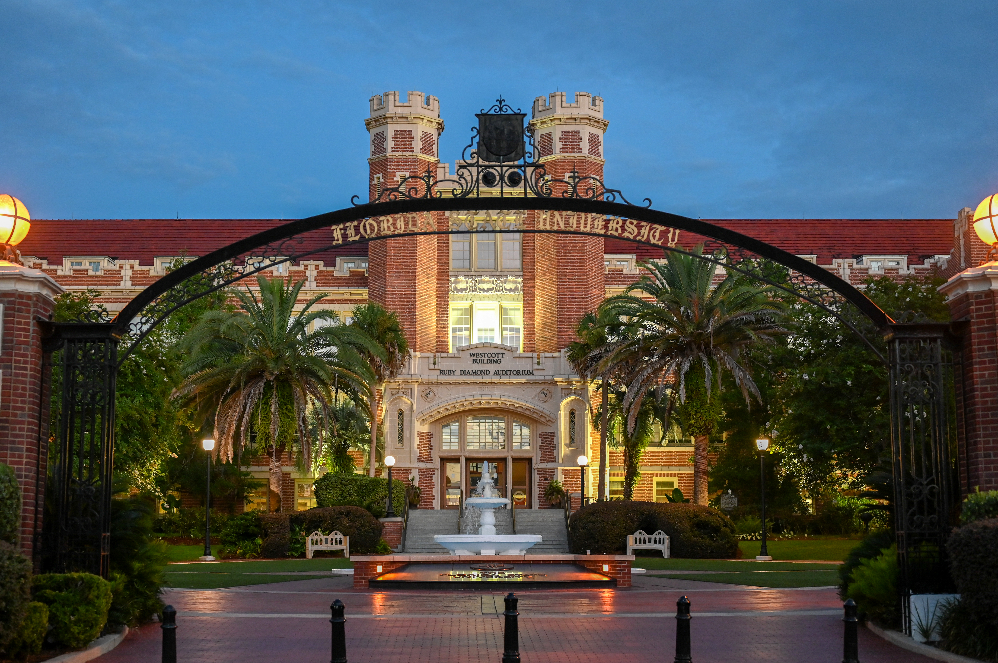
Choose one FSU lockup/logo to include on your poster (required)
UROP logo must be included on your poster
PRESENTATION TITLE 120 pt. font
Student Presenter(s) and Research Mentor (66-88 pt. font)
Student names must be underlined, and mentor’s name must be included on the poster
36 pt. Poster Section Title:
Body font no smaller than 24 pt. It is suggested to avoid paragraphs; use bullet points.
Outline what you plan to include below
36 pt. Poster Section Title:
Body font no smaller than 24 pt. It is suggested to avoid paragraphs; use bullet points
Outline what you plan to include below
Image captions should be no smaller than 18 pt. font and images should be at least 300 DPI to be clear and sharp on the poster.
General Poster tips and recommendations
Poster sections generally encompass background/introduction, Methods, results, conclusions , and future directions. Sections should be discussed with your research mentor to create the most impactful poster.
Sans Serif fonts are often more accessible to keep the color of the poster very light overall; we cannot print posters that have large areas of dark or bright colors.
The poster should be 48 in wide x 36 in tall (the dimensions of this template).
It should be submitted as a PDF
Use no more than two fonts on your poster, one for the title, and one for the rest of the poster .
Your poster PDF file title should be in the following format: lastnamefirstinitial_poster
ex: BataillesA_poster
If you are part of a group, your poster PDF file title should be in the following format, including the last name and first initial of each group member:
Group_1stpresenterlastnamefirstinitial, 2ndpresenterlastname, first initial_poster
ex: Group_BataillesA, AdventD_poster
36 pt. Poster Section Title:
Body font no smaller than 24 pt. It is suggested to avoid paragraphs; use bullet points
Outline what you plan to include below
36 pt. Poster Section Title:
Body font no smaller than 24 pt. It is suggested to avoid paragraphs; use bullet points.
Outline what you plan to include below.
Resources (Required poster section)
Body font no smaller than 24 pt. Can start with papers from annotation organizer

