Slide 1
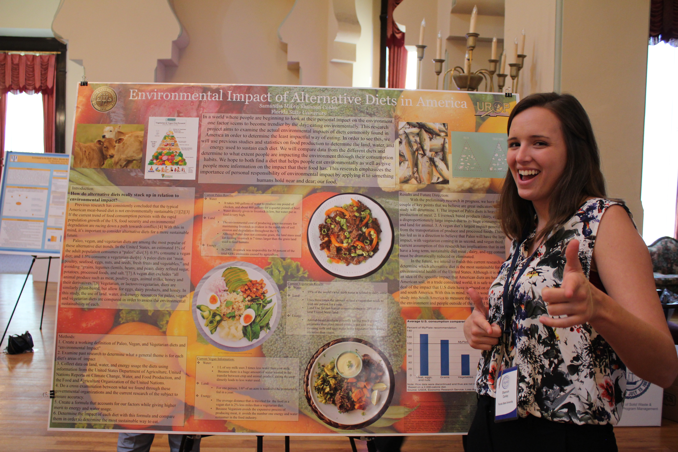
Creating an Impactful Poster
Presented by: Kim Reid & Jenni Batchelder
Notes:
Who has done a poster session before? What advice do you have?

Slide 2
Overview
Getting Started in PowerPoint
Formatting
The Header
The Information
Section Themes
Styling Tips
Examples
Digital Studio
Preparing for the Presentation: Elevator Speech

Slide 3
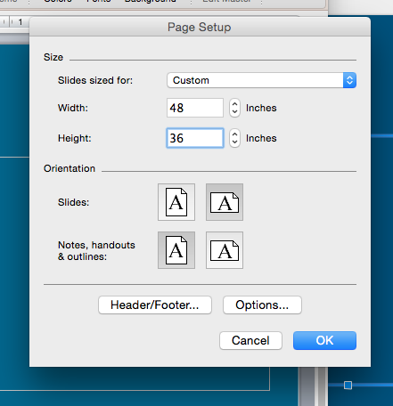
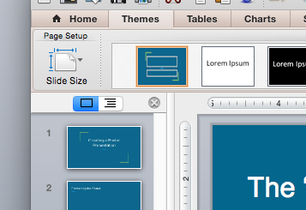
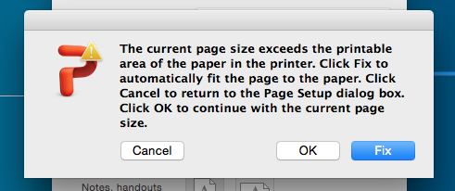
Use PowerPoint to create a 48” x 36” slide
Getting Started in PowerPoint -Mac
Find Tab that asks for slide size
Click “OK”
Then start your outline

Slide 4
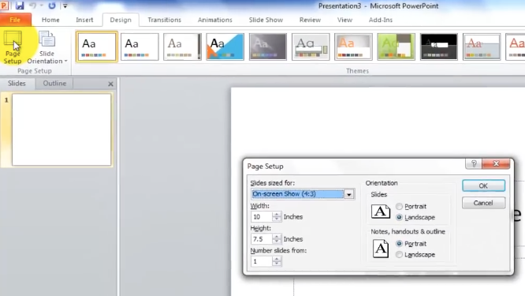
Use PowerPoint to create a 48” x 36” slide
Getting Started in PowerPoint -PC
Find the Design Tab
Select Page Set Up
Change the Width to 48
Change the Height to 36
48
36
Then start your outline

Slide 5
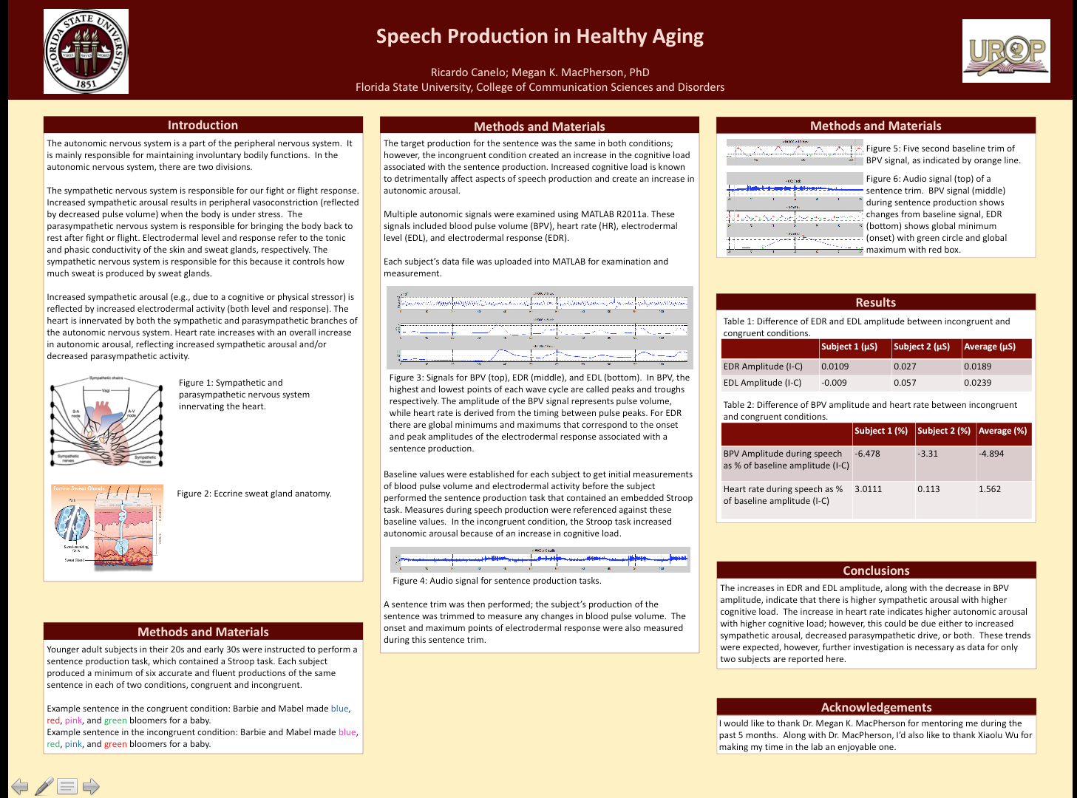
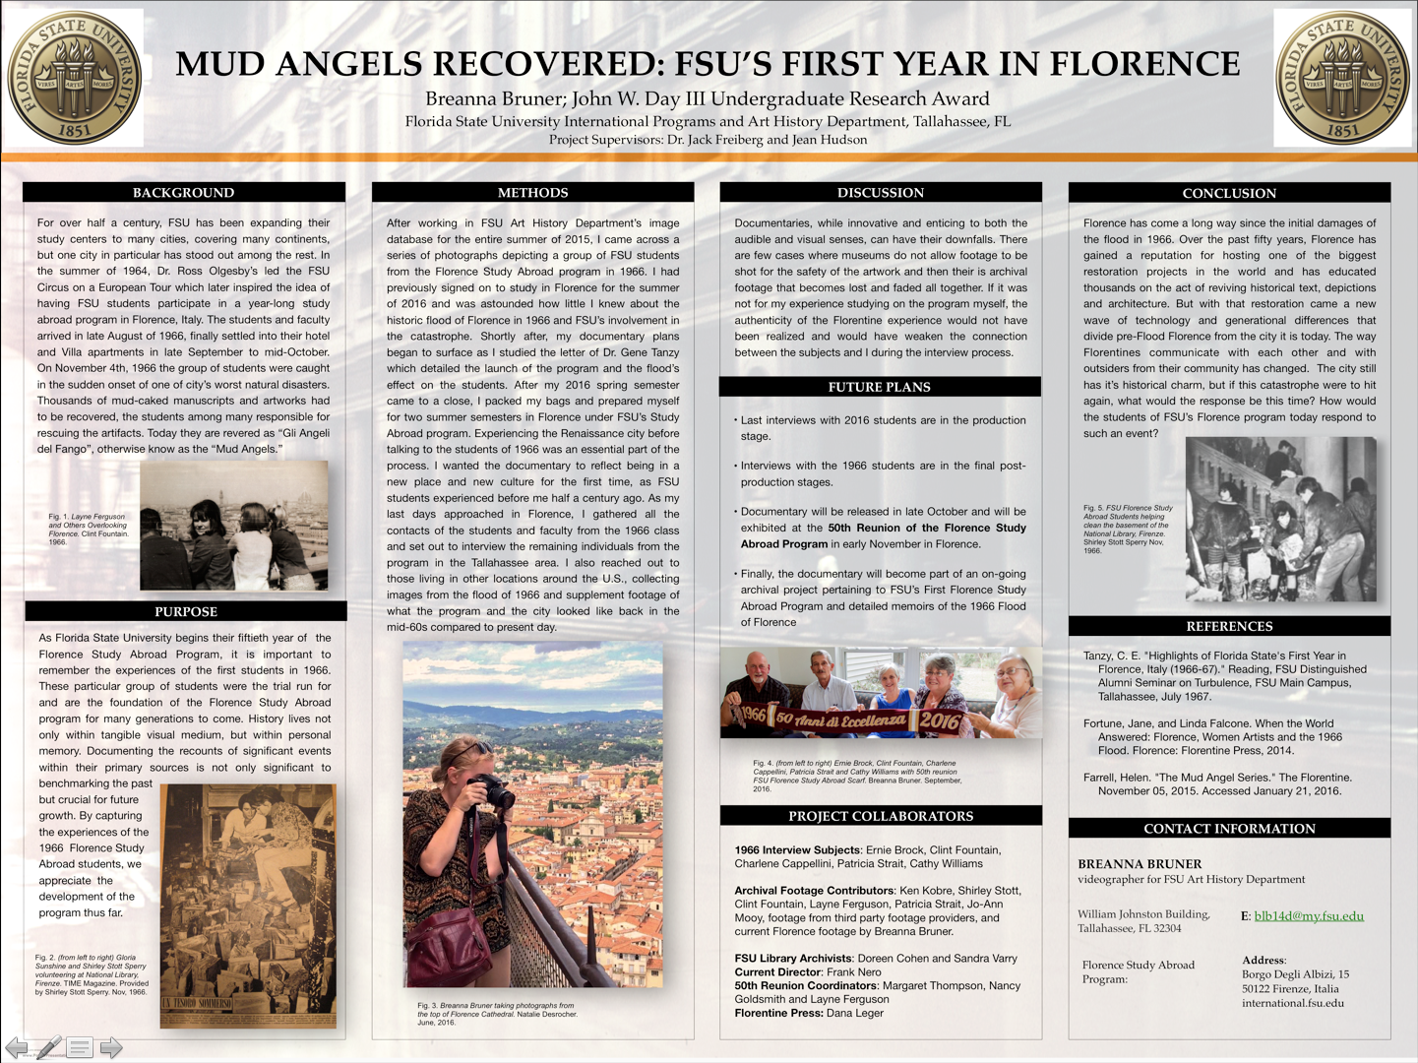
Formatting
With a quick glance,
what are the commonalities for these posters?

Slide 6
Formatting: The Header
Should Include
Research Title (120 pt. font)
Your Name (66 to 88 pt. font)
Any Team Member Names (66 to 88 pt. font)
Your Mentor’s Name (66 to 88 pt. font)
FSU Logo (found on CRE website under Presentation Resources)
Sponsoring Department or Organization Logo and/or Donor Name

Slide 7
Formatting: The Information
Use textboxes to make the sections of your poster. Make sure:
Text is readable from a few feet away (24 pt font+)
Text stands out from the background color
Zoom in to make sure that text doesn’t overflow the textboxes or accidentally hidden
Section Themes to Include (Next Slide)

Slide 8
Formatting: Section Themes to Include
Abstract
Introduction
Background
Methods
Results
Discussion
Limitations
Conclusion
Future Directions
Acknowledgements
References
(Posters don’t necessarily have to include every single one of these sections)
View examples of past posters:
https://fsu.digital.flvc.org/islandora/object/fsu:undergraduate_research_symposium

Slide 9
Formatting: Style Tips
Less is More
Your poster should not be a wall of text! Don’t make your sections too lengthy or the text too small.
Color
No dark solid color backgrounds (uses up a lot of ink!)
Use Images and Graphs
The poster is an illustrative backdrop to your “elevator speech.”
Include pictures and charts/graphs from your research experiences whenever possible - just make sure that they are high quality and not grainy.
Easy Reading
Make sure fonts and colors are easy on the eyes and readable.
24 pt font or higher
Keep It Classy
Stick to one or two fonts. Feel free to be creative, but check that your poster’s color scheme is easy on the eyes.

Slide 10
Formatting: Images
Graphics should have a purpose
Your graphics/images should not be pixilated
Pictures 300 dpi and 1000x1000 or larger
Images and graphs 5”x7” or larger
Graphs are two-dimensional, simple, and easily understood
Create your graphs within PowerPoint rather than importing a picture of a graph or a graph from another program (e.g. SPS)

Slide 11
Example Posters
There is no one way to accomplish posters!
These examples aren’t perfect.
What would you change to better communicate their research?

Slide 19
The “Elevator Speech”
The elevator speech is a 1-2 minute summary of your research that explains the basis of the project while engaging the listener so they become interested in hearing more.
Clarity is Key
Assume the listener has no knowledge of the specific terms related to your field of study.
Explain major terminology important to your research
Be sure to be loud enough to be heard

Slide 20
The “Elevator Speech”
Be Approachable!
Smile
Invite people into your area
Look up and be aware of body language
Pay attention to the reaction of the people you are speaking to so you can know when to go on and give more details and when to stop.
Remember to ASK your audience if they have questions.

Slide 21
Digital Studio
Two Locations
Williams 222B
Johnston Ground G062
What Do They Do?
How They Can Help?
Technical Knowledge
Software Tutorials
Adobe Creative Suite
Web Design
Research Posters
Workshops
Rhetorical Sophistication
Project Consultation
Drafting Guidance
Design Feedback
Revision Strategies
Planning
Research Posters as a Genre
Software Tutorials
Microsoft PowerPoint
Microsoft Publisher
Adobe InDesign
Adobe Illustrator
Drafting
Individual Consultations
Drafting Workshops
Feedback and Revision Workshops
Muli-Step Workshops
Printing
Free printing posters for UROP students

Slide 22
Digital Studio
How to Get In Touch
Email: fsudigitalstudio@gmail.com
Workshop Scheduling at: https://docs.google.com/forms/d/e/1FAIpQLSemaFaDMTV1RxWfDr5g-IbJZRXC7rUoGbtJcXL319UITU_aYQ/viewform
To Administrators:
Williams –Travis Maynard tmaynard@fsu.edu
Johnston Ground –Kamila Albert -ka16f@my.fsu.edu
Hours
Monday – Thursday: 10am to 4pm
Fridays: 10am to 2pm

Slide 23
Quick Reminders
Review the Research Poster Checklist Here
Be sure to save your poster as a PDF
Friday, March 9th - the deadline to submit your poster to CRE for printing.
To have your poster printed by the CRE, please submit a PDF of your poster through DropBox:
Step 1: Go to https://dropbox.fsu.edu/
Step 2: Log in with your FSUID and password
Step 3: Select "Drop Off" and enter alicia.batailles@fsu.edu and jbatchelder@fsu.edu as your recipients and attach the PDF.
**Make sure to submit your file as a PDF to ensure that formatting does not get shifted around. Use Dropbox - do not email us your poster!**
Wednesday, March 28: Date printed poster is due to CRE if your department is printing poster for you.

Slide 24
Thank you!
Any Questions?

